Slide 1

CSC6052/5051/4100/DDA6307/MDS5110 Natural Language Processing
Tutorial 5: Train your own LLMs
Spring 2024
Benyou Wang
School of Data Science

Slide 2

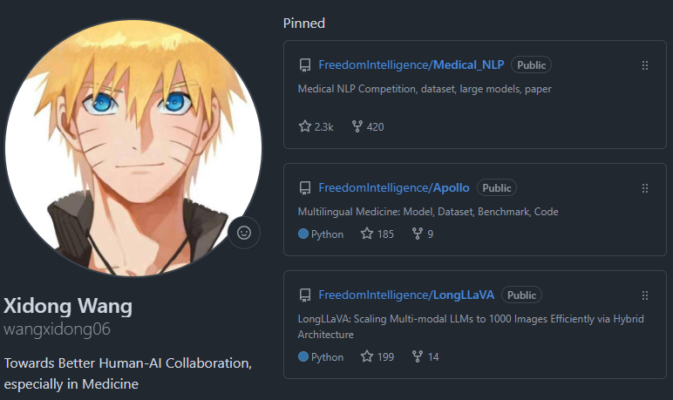
Self Introduction
A Second-Year PHD
Towards Better Human-AI Collaboration, especially in Medicine
CMB, Apollo, LongLLaVA, ApolloMoE, TinyDeepSeek ...
https://github.com/wangxidong06
https://github.com/wangxidong06

Slide 3
Context
Train Your Own LLMs
Colab Practice

Slide 4
Train Your Own LLMs
Notes:
The first part is train you own LLMs.

Slide 5
Overall Process
Typically, training your own LLMs contains the following five main steps:
Load pre-trained model and tokenizer (or from scratch?)
Data preparation
Start training
Save your trained model
Evaluate your trained model on a given test dataset

Slide 6
Training Tricks
You can use other parameter-efficient fine-tuning methods to be able to fine-tune large models on limited GPU resources.
Here, we introduce some useful open source github project that may help.
PEFT: https://github.com/huggingface/peft
OpenDelta: https://github.com/thunlp/OpenDelta
QLoRA: https://github.com/artidoro/qlora
unsloth: https://github.com/unslothai/unsloth

Slide 7
Training Frameworks
Using notebooks for long-term model training is inconvenient in some cases. You can also try the following alternative model training frameworks:
LLMZoo: https://github.com/FreedomIntelligence/LLMZoo
stanford_alpaca: https://github.com/tatsu-lab/stanford_alpaca
LlaMA-Factory: https://github.com/hiyouga/LLaMA-Factory
FastChat: https://github.com/lm-sys/FastChat
DeepSpeed-Chat: https://github.com/microsoft/DeepSpeedExamples/tree/master/applications/DeepSpeed-Chat
MS-SWIFT: https://github.com/modelscope/ms-swift

Slide 8
2. Colab Practice

Slide 9
Practice of Train your own LLMs
If you're new to using LLMs, don't worry; we've prepared a notebook for you:
https://colab.research.google.com/drive/1AP5kIzo_BKqfmmY8pl4l2kkNec8zkMoh?usp=sharing
1. Load Model, Tokenizer and Template for Chat Model.
2. Process Data for Training.
3. Train Model with Qlora.
4. Evaluate Model's performance.
5. Save and Deploy Trained Model.
This will guide you on

Slide 10
2.1 About Python Package

Slide 11

About Package Installation
About pip args:
-q: Quiet mode, reduces output information.
-U: Upgrade to the latest version if already installed.
About Installation Patterns:
Install from PyPI: pip install -q -U bitsandbytes
Install from GitHub: !pip install -q -U git+https://github.com/huggingface/transformers.git
What’s the Difference? Install from git in the newest version (or dev version)
Can not ping PyPI or github? Install from predownloaded code or .whl (recommand).
pip install /path/to/local/package or package_name.tar.gz or package_name.whlpa ckage_nam e.tar.g

Slide 12
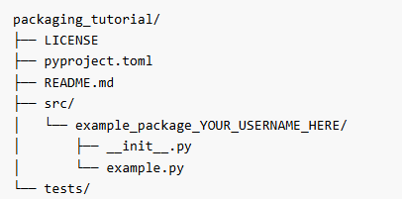
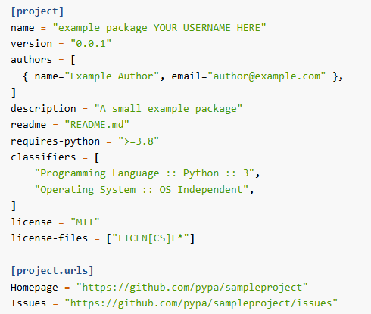
More About Python Package
How to release my own Python Package? Write a pyproject.toml file
Your Project Code Template：
The basic pyproject.toml Template：
Please refer to Official Documentation for more details

Slide 13
2.2 About Quantization (Q-Lora)

Slide 14
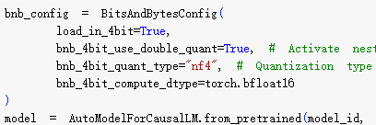
What is bitsandbytes?
“The bitsandbytes library is a lightweight Python wrapper around CUDA custom functions, in particular 8-bit optimizers, matrix multiplication (LLM.int8()), and 8 & 4-bit quantization functions.”
IT IS FOR Quantization~
What is Quantization?

Slide 15
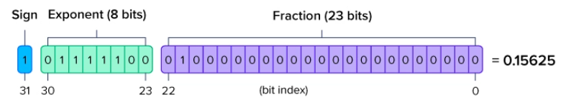
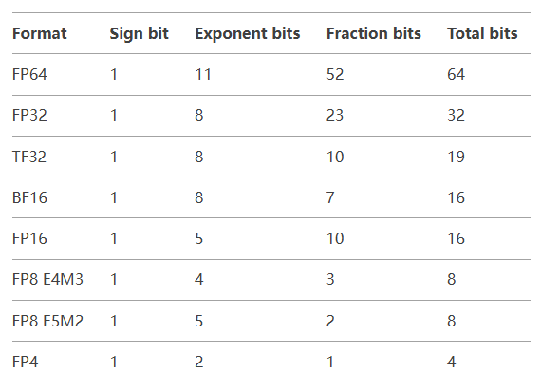
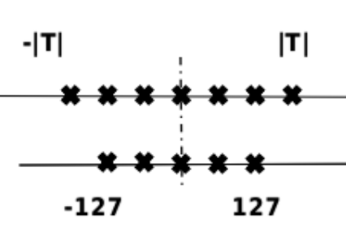
What is Quantization?
FP32
Int8 Quantization

Slide 16
What is Quantization? Why it’s Important?
Int8 Quantization
[-0.9, -0.5, 0, 0.1, 0.9, 1.3, 1.7, 2.0]
Max: 2.
ratio: 127/2=63.5 0.1 (8bit float): 0.1->0.1*ratio=0.1=6.35
0.1 (8bit quant): 6
0.1 (8bit dequant): 6/ratio=0.0944

Slide 17
What is Quantization? Why it’s Important?
Int8 Quantization
[-0.9, -0.5, 0, 0.1, 0.9, 1.3, 1.7, 2.0]
Max is Key
Max: 2.
ratio: 127/2=63.5 0.1 (8bit float): 0.1->0.1*ratio=0.1=6.35
0.1 (8bit quant): 6
0.1 (8bit dequant): 6/ratio=0.0944

Slide 18
Double quant for Qlora
Max is Key
Int8 Quantization
Block-Wise
[-0.9, -0.5, 0, 0.1, 0.9, 1.3, 1.7, 2.0]
N numbers as 1 Block, calculating Max within a Block, and performing quantization operations
Assuming there are 1024 numbers, when N=8 and N=256:
1024/8 = 128, requiring 128 additional absmax auxiliary numbers (FP32).
1024/256 = 4, requiring 4 additional absmax auxiliary numbers (FP32).
absmax auxiliary numbers also can be Quantified
Double quant

Slide 19
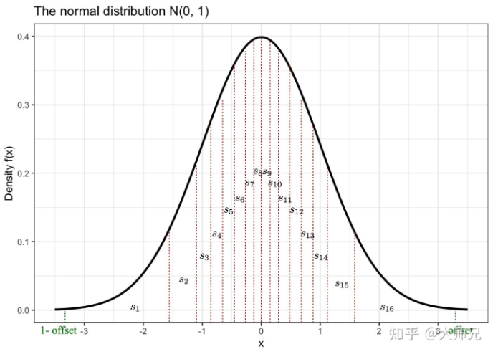
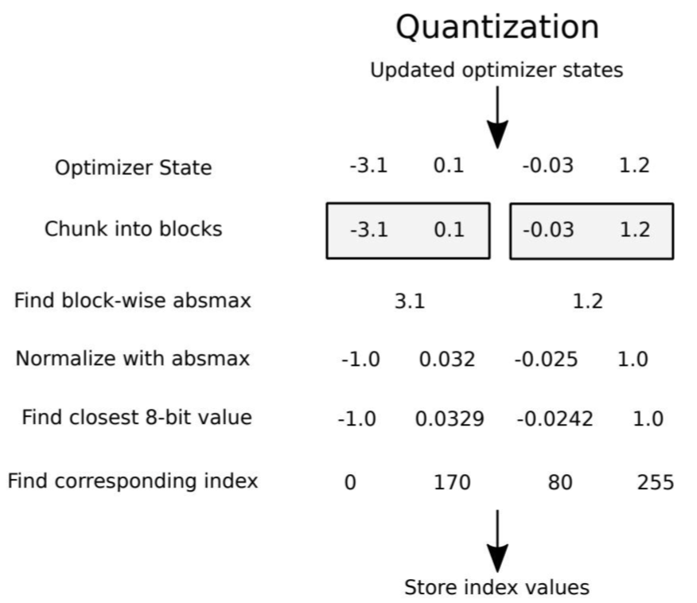
NF4 for Qlora
Tim Dettmers Theoretical Optimum :
“When quantizing the input data, the frequency of occurrence of each possible k-bit integer value is equal.”

Slide 20
2.3 About Gradient Checkpointing

Slide 21
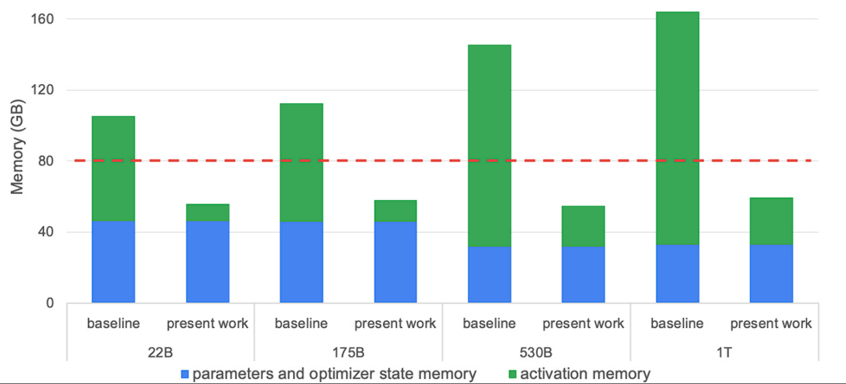
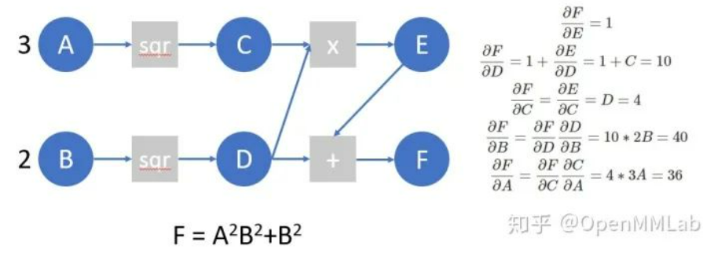
The Activation During Training
During the training of the Transformer model (and other neural network models),
activations are stored because they are used again during the backpropagation process.
Minimizing Activations is the mission of Gradient Checkpointing

Slide 22
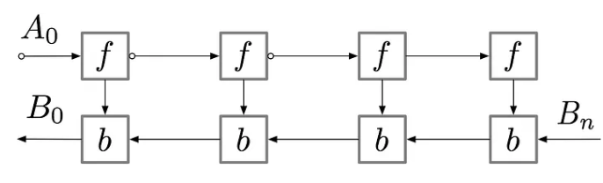
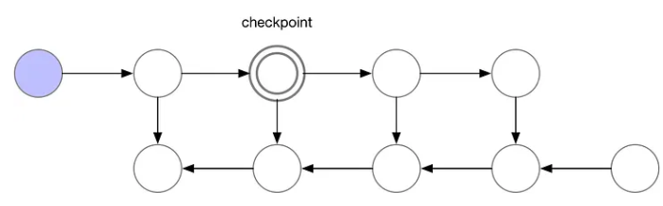
Gradient Checkpointing (GC)
GC: Recomputing Forward for BackWard
For a simple feed-forward neural network with n layers, gradient computation graph can be pictured
Forward
Backward
w/o GC we need store
at least 7 “point” at the peak
w/ GC we only need store
at most 3 “point” at the peak

Slide 23
2.4 About Template of Chat Model

Slide 24
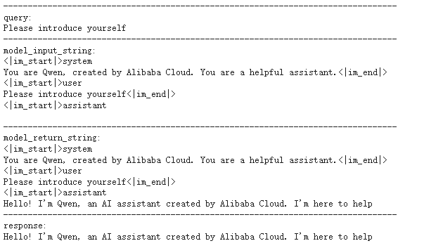
Inference

Slide 25

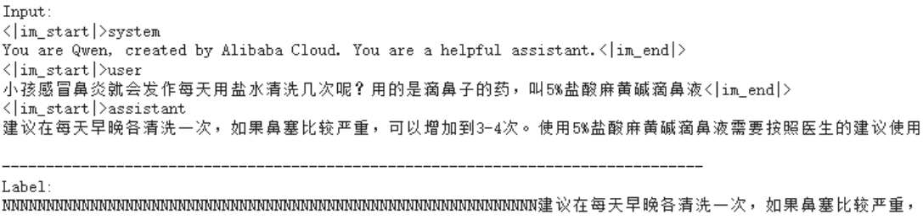
Training

Slide 26
2.5 About TrainingArguments

Slide 27
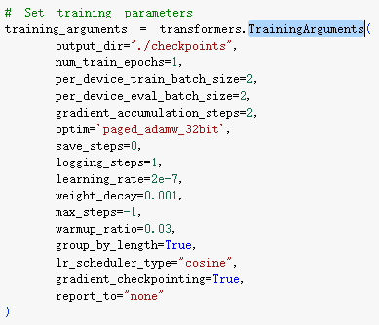
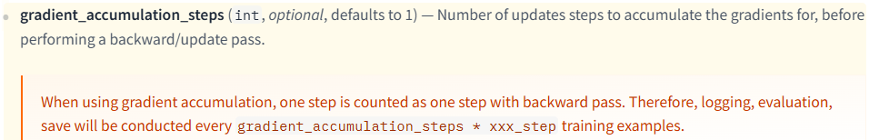
Training Arguments
Just refer to Official Documentation and search
For Example:
gradient_accumulation_steps?
weight_decay?

Slide 28
Thanks

